Slide 1
There Goes Your PIN Exploiting Smartphone Sensor Fusion Under Single and Cross User Setting
David Berend, Dr. Shivam Bhasin, Dr. Bernhard Jungk
Temasek Laboratories at Nanyang Technological University
Hardware Assurance Group
28th August, 2018
13th September, 2018

Slide 2
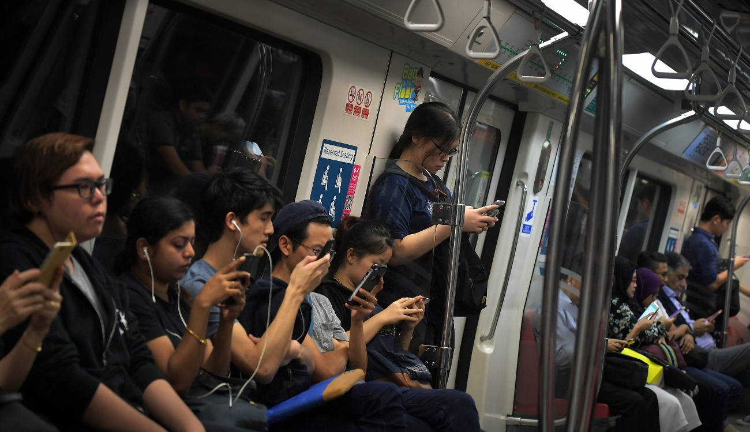
Background
Smartphones evolved to daily companions

Slide 3
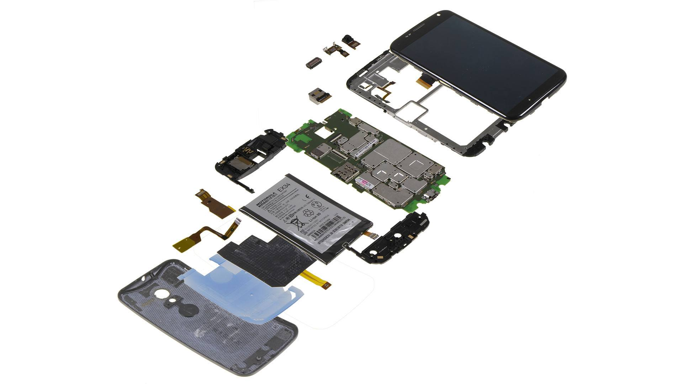
Background
Equipped with various motion and health sensors

Slide 4
Background
Sensor data accessible without permission

Slide 5
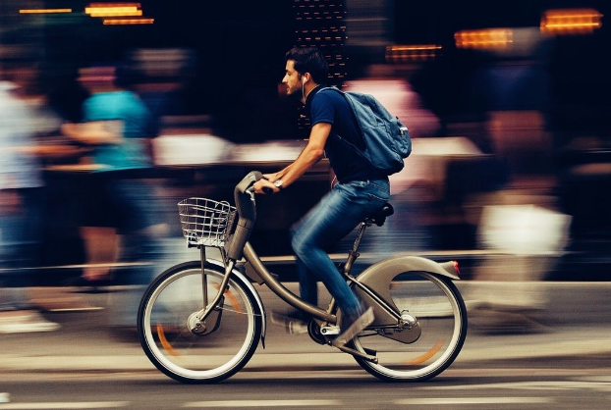
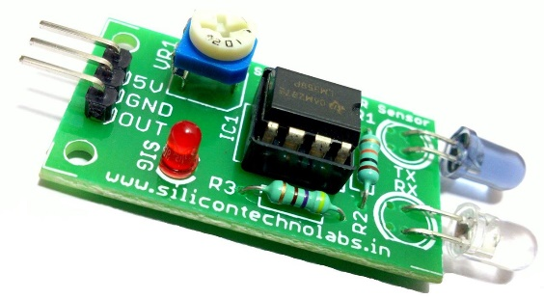
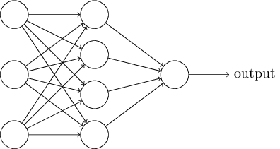
Background
Data used to gain insights on private information

Slide 6
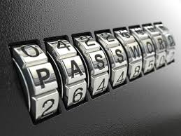
Background
Data used to gain insights on private information

Slide 7
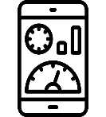
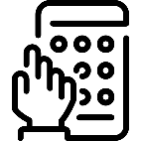
Scenario
* * 8 7
Install malicous application
Train classification system with sensor data
Measure sensors during password-input
Classify and reconstruct password
Unlock smartphone with classified password

Slide 8
Implementation
Save measured sensor data
Preprocess cut data streams
Link sensor data to keys
Train & test classifier
* * 8 7

Slide 9
Our Approach
Previous work
This work
Four keys combined being classified
Keys classified individually
10,000 classes trainable
50 combinations trained
Tested with training data
10 classes trainable
10,000 combinations classifiable
Separate testing with ~500 recordings

Slide 10
Sensor Success & Algorithmic Performance*
*accumulated success after 20 guesses

Slide 11
Optimization & Insights*
Enlarging the data stream of PIN‘s digit
 | 0 ms | 25 ms | 50 ms
0 ms | 74.10% | 68.70% | 71.40%
25 ms | 78.20% | 70.10% | 72.10%
50 ms | 83.70% | 76.90% | 75.50%
Inclusive and exclusive training
 | A | B | C | ABC
A | 70.10% |  |  | 79.60%
B |  | 16.70% |  | 30.00%
C |  |  | 17.90% | 20.50%
 | AB | BC | CA
A |  | 6.10%
B |  |  | 6.70%
C | 5.30%
*accumulated success after 20 guesses

Slide 12
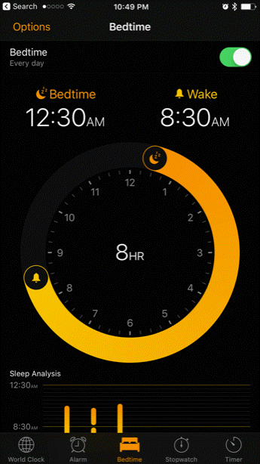
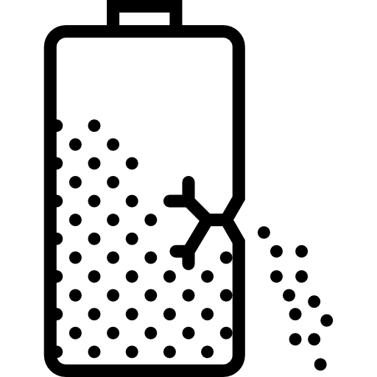
Further Applications
Behavioural Profiling
Daily
Cycles
Tapping
Behaviour
Battery
Leakage

Slide 13
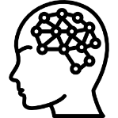
Implications of AI on Mobile Security
Mobile devices have become powerful enough to run extensive machine learning algorithms themselves
New developed sensors are highly accurate, thus reducing noise and increasing learning potential
Data accessibility is still very high, which causes an open door to private information for the public

Slide 14
Countermeasures
Developer
OS
Randomised keyboard
Disabling sensors during sensitive input
Fast frequency certificate
Disabling background sensor measurement
Manufacturer
Consumer
Implementing sensors with less frequency
Raising higher awareness
More permissions to grant
*accumulated success after 20 guesses

Slide 15
Thank You!

Slide 16
Q&A

