Slide 1
The Race to Secure Texas Instruments Graphing Calculators
Brandon Wilson

Slide 2
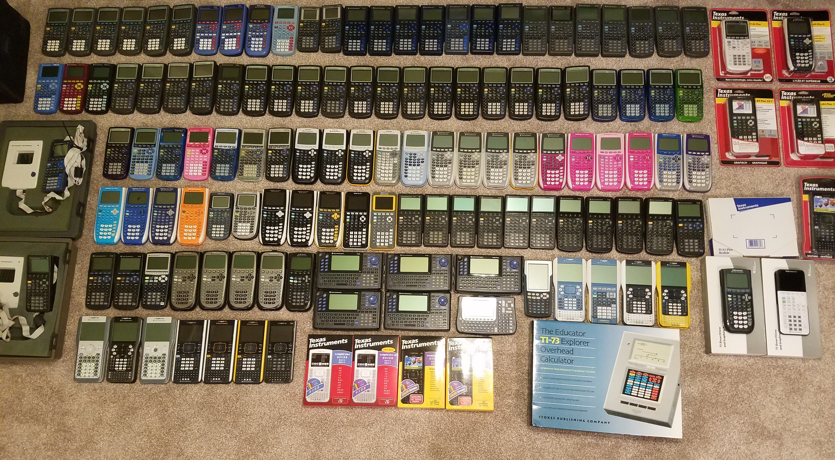
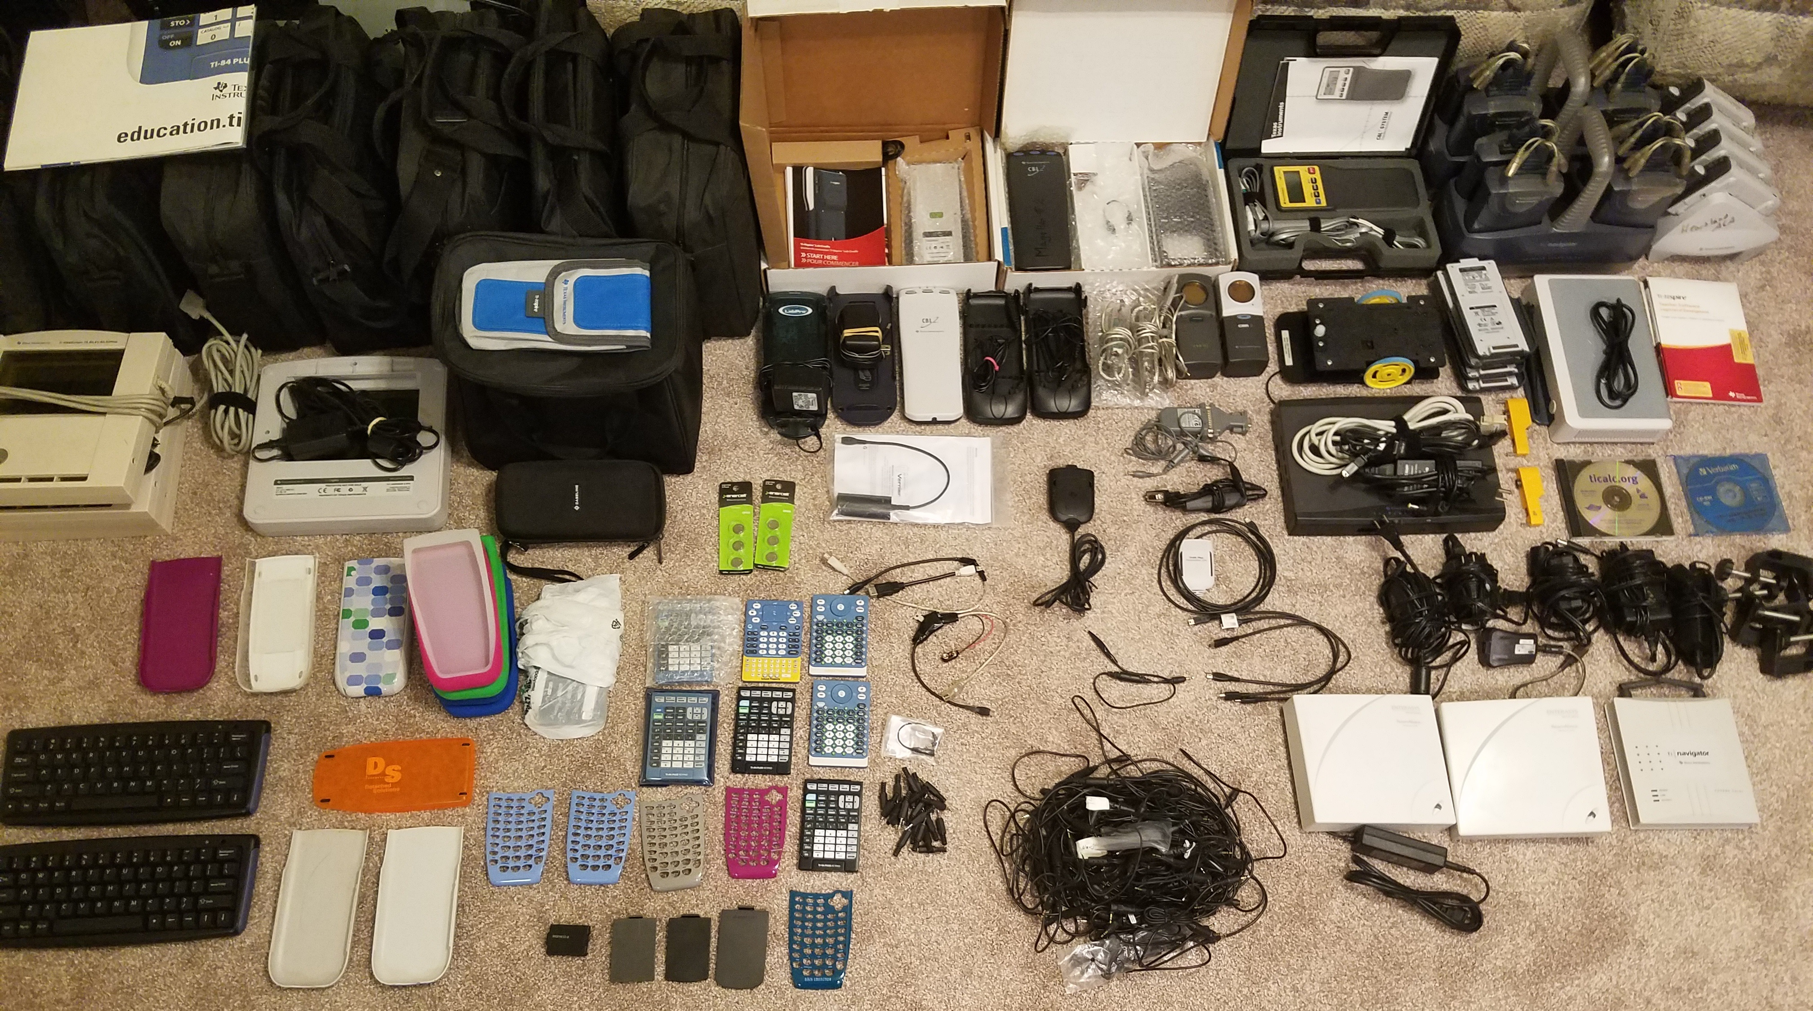
Who am I?
Calculators got me started in software development / security industry
World’s largest collection

Slide 3
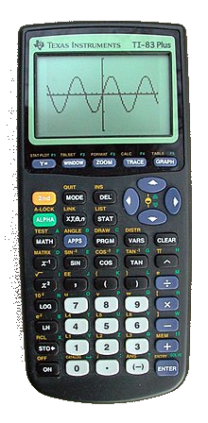
What is a graphing calculator?
First and foremost – a calculator
Capable of graphing equations
Programmable
TI-BASIC
Assembly language (Z80, M68K, ARM, eZ80)
C
Python
2.5mm I/O port (sometimes USB)
Calculator<->calculator communication and sharing of variables
PC<->calculator communication and sharing of variables, backups, programs, etc.

Slide 4
The Zilog models
Zilog Z80
6MHz (on some models, up to 15MHz)
8-bit CPU
16-bit addressing (64KB maximum)
8-bit port I/O
IN/OUT instructions
Anywhere from 32KB RAM all the way up to 128KB
Some have Flash memory, anywhere from 1MB up to 4MB

Slide 5
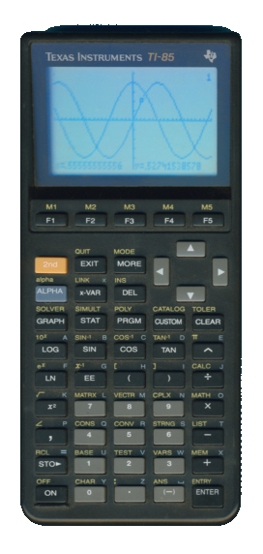
The zilog models - ZShell
First model to run assembly programs
Bets internally at TI on whether we’d figure out a way
OS supports “backups” via TI-Graph Link I/O cable
Just dumps of system and user RAM
OS also supports “custom” menu entries
Entries are stored in system RAM as address of OS code handling command
So…we just change the address to code we place in safe spot of system RAM
ZShell (program that executes other programs) is started from CUSTOM menu
Programs as stored as TI-85 “STRING” variables

Slide 6
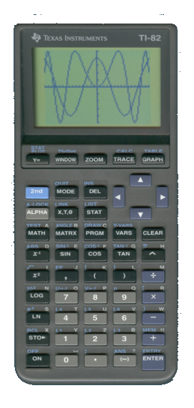
The Zilog Models - TI-82
TI-82 also had to be hacked
No CUSTOM menu
System RAM has table of handler addresses for system events
“Context vectors” – handlers for “system contexts” like homescreen, graph screen, etc.
cxMain vector – keypress handler (if only we could modify it)
“REAL” variables (numbers) can be copied from one to another (e.g. X->Y, 1->Z)
REAL variables are 9 bytes
When storing from one variable to another (X->Y), these 9 bytes are just copied blindly
PC backups contain system RAM…and user RAM, including pointers to X, Y, etc.
Modify X’s 9 bytes to contain address of code we want to execute
Modify Y to point to…cxMain
X->Y will copy X’s 9 bytes (arbitrary) to cxMain…then press a key, and we have control
Similar shells exist for TI-82

Slide 7
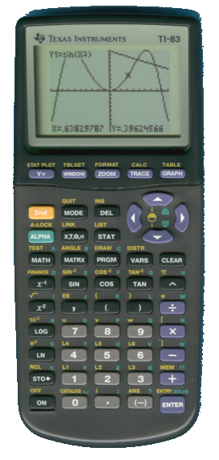
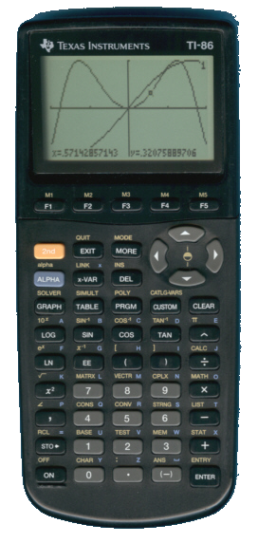
The Zilog Models – TI-83/TI-86
TI-83 actually has an assembly program backdoor
Send( command will send variable to calculator connected to I/O port
e.g. Send(prgmQUADSOLV
Send(9 … executes assembly program
e.g. Send(9prgmSHELL
TI-86 has native assembly program support via Asm( command
e.g. Asm(prgmGAME
TI even provided basic documentation for system and user RAM, OS hooks, etc.

Slide 8
The Zilog Models – Flash Upgradeability
TI-73/Explorer
TI-83 Plus
TI-83 Plus Silver Edition
TI-84 Plus
TI-84 Plus Silver Edition
European-only “improvements”:
TI-82 Advanced (essentially TI-84 Plus with anti-cheating LED instead of I/O port)
TI-84 Plus T (essentially TI-84 Plus Silver Edition with anti-cheating LED instead of I/O port)

Slide 9
The Zilog models – Flash upgradeability
There is no TI-84 (without the “Plus”)
Until they came out with the “TI-84 Pocket.fr” (which is really a physically-smaller TI-84 Plus)
European duplicates
TI-82 Stats (really TI-83)
TI-82 Stats.fr (really TI-83)
TI-83 Plus.fr (really either TI-83 Plus or TI-84 Plus Silver Edition)
(yes, they really used the exact same name for two different models)
TI-82 Plus (really TI-83 Plus)
TI-82 Advanced (really TI-84 Plus)
TI-83 Premium CE (essentially TI-84 Plus CE)
TI-84 Plus T (really TI-84 Plus Silver Edition)

Slide 10
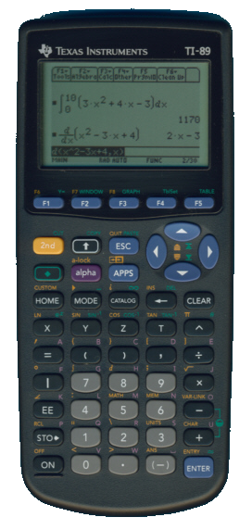
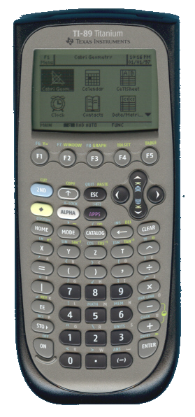
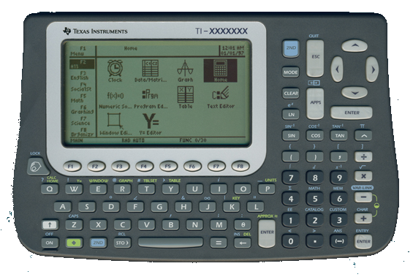
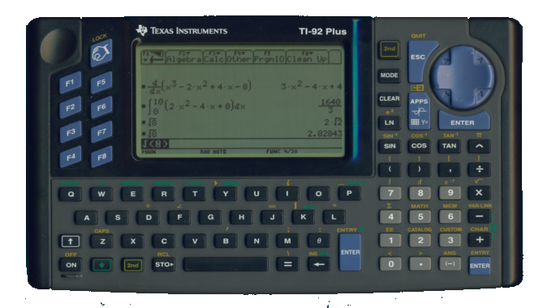
The Motorola 68k Models
TI-92
TI-92 II
Also sold expansion modules (TI-92 E, TI-92 II) to convert original TI-92
Essentially just more RAM and language selections
TI-89 (contains Flash chip and OS/application upgradeability)
TI-92 Plus module (converted TI-92 to TI-92 Plus)
Added Flash chip, changed it to an entirely different calculator
TI-92 Plus
TI-92 with Plus module integrated within it)
Voyage 200 (same as TI-92 Plus)
TI-89 Titanium
Added USB port, minor hardware changes

Slide 11
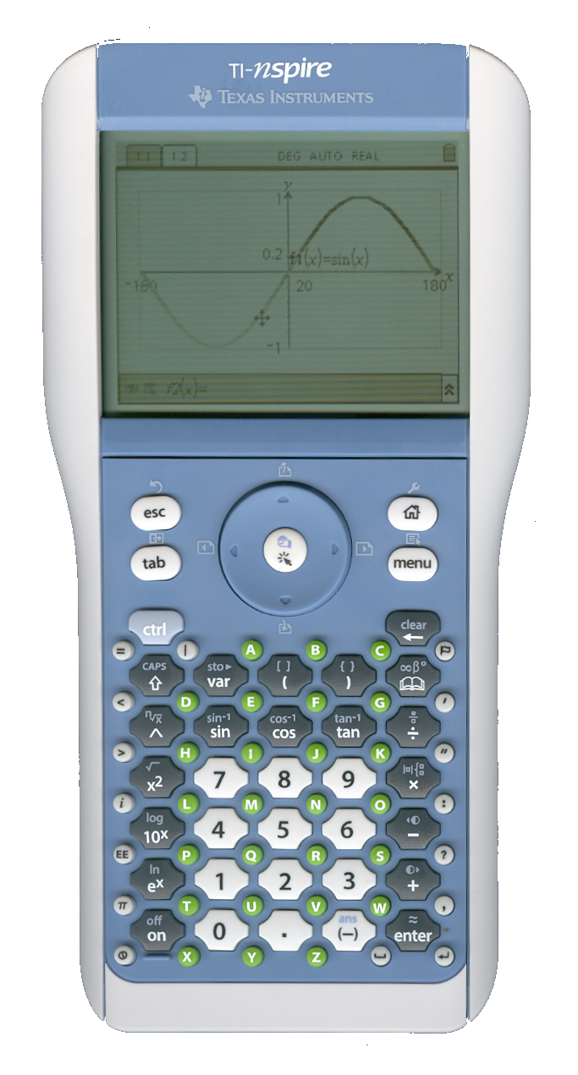
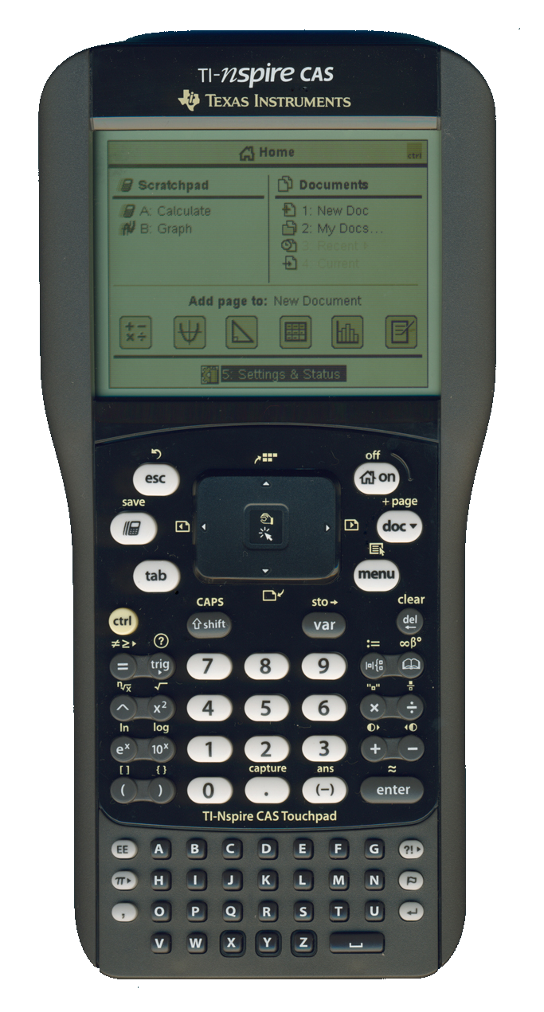
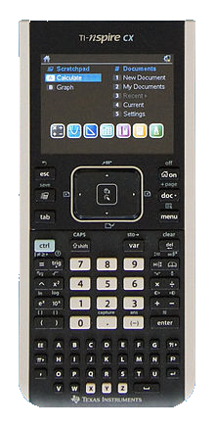
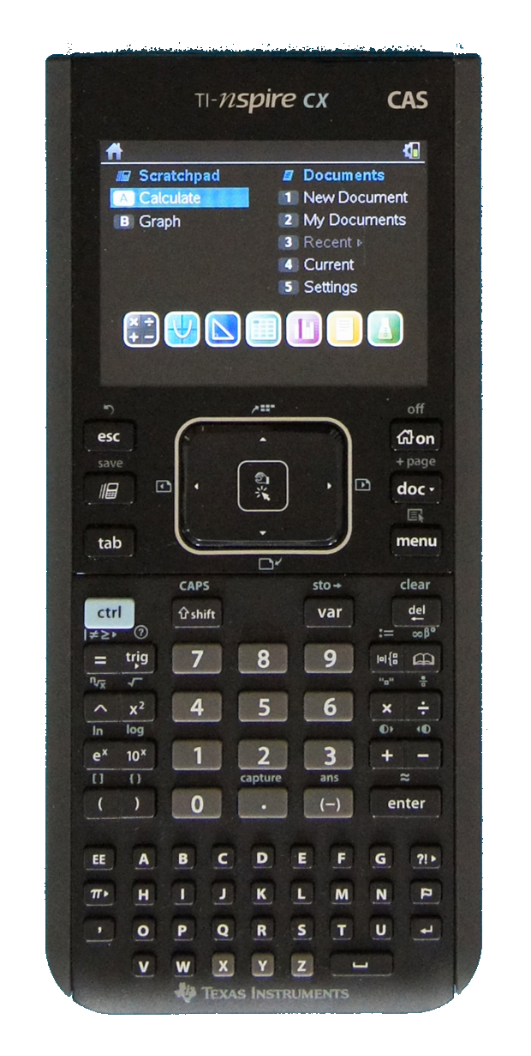
The TI-Nspire models (ARM)
TI-Nspire (not NSpire, nSpire, nspire, Inspire, etc.)
Different swappable keypads (84+, ClickPad, TouchPad)
TI-84 Plus emulation mode with 84+ keypad
Both non-CAS and CAS versions
TI-Nspire CX
Color LCDs
Both non-CAS and CAS versions
Chinese variants (slightly less memory)
Completely locked down (no native code)
Ndless

Slide 12
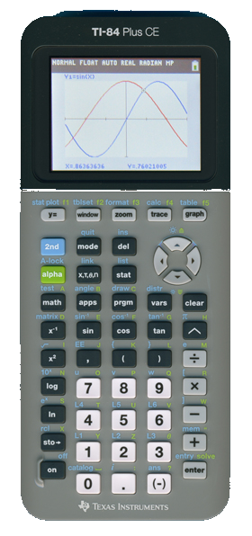
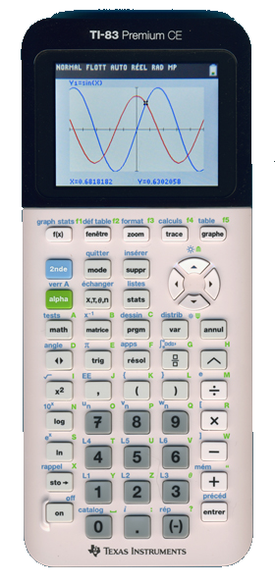
The eZ80 Models
TI-84 Plus CE
eZ80 – 24-bit addressing, Z80 backwards compatibility
Completely new ASIC (and security design)
Flat memory model instead of paging/bank switching
Color LCD
TI-83 Premium CE
European-only
Exact math engine
TI-84 Plus CE-T
European version of TI-84 Plus CE

Slide 13
Cool things you can do
USB host communication
Bluetooth adapters
Serial adapters
Wi-Fi adapters
USB flash drives, hard drives, floppy drives, …
Keyboards and mice
PS3 jailbreak (abuse of USB protocol)
USB device simulation
Skylanders: Spyro’s Adventure
Disney Infinity
Lego Dimensions
Bootable USB flash drive
Keyboards and mice

Slide 14
Why have security in calculators?
Non-free Flash applications
Games, enhanced math capabilities, other functionality (organizer, periodic table, etc.)
Creators wouldn’t want these applications copied for free
Anti-cheating functionality
Disable certain math functions during tests
Prevent accessing notes/helper programs during tests
Prevent tampering of operating system
We could make a better OS than TI’s in terms of math, performance, etc.

Slide 15
Key Players in Security Race
Texas Instruments
Pressure from educational institutions/teachers
Prevent cheating during tests, games during class
TestGuard
Press-to-Test
The user community
Maintain control over hardware we own
New OSes/math functionality, games, repurposing hardware (USB, Wi-Fi), …
Let’s dig in

Slide 16
Z80 Model Basics
ASIC
Flash Chip
I/O
1MB
or
2MB
or
4MB
CPU
6MHz or 15MHz
RAM
32KB or 48KB or 128KB

Slide 17
Z80 Model Basics - CPU
Zilog Z80 8-bit CPU – 6MHZ default, capable of switching to 15MHz
16-bit addressing
64KB memory map (0x0000 – 0xFFFF)
Split into 4 16KB “pages”/banks
8-bit I/O addressing
Ports 0x00 through 0xAF
ASIC configuration, hardware I/O (LCD, keyboard, USB, etc.), …

Slide 18
Z80 Model Basics – memory map
0x0000 – 0x3FFF
0x4000 – 0x7FFF
0x8000 – 0xBFFF
0xC000 – 0xFFFF
ROM Page 00
or
ROM Page 7F
Any ROM Page
or
Any RAM Page
Any ROM Page
or
Any RAM Page
Any RAM Page
(Port 0x06)
(Port 0x07)
(Port 0x05)

Slide 19
Z80 Model Security Basics
Port 0x14 – Flash Protection Control
Write 0x01 to unlock; 0x00 to (re)lock
Special sequence must be executed from a “privileged” Flash page:
nop
nop
im 1
di
out (14h),a
Privileged Flash pages: 1C-1F (83+), 3C-3F (84+), 6C-6F and 7C-7F (83+SE/84+SE)
Boot page(s): 1F (83+), 3F (84+), 6C-6F and 7F (83+SE/84+SE)
OS pages: 1C-1D (83+), 3C-3D (84+), 7C-7D (83+SE/84+SE)

Slide 20
Flash Unlocking
OS upgrade loop:
Receive Flash page:address and OS data
Boot code unlocks Flash with privileged sequence (and checks for trickery*)
Writes OS data to Flash page:address
Boot code relocks Flash with privileged sequence
All Flash-related OS functionality:
Always unlock Flash, perform simple operation quickly, relock Flash

Slide 21
Flash Unlocking – Potential trickery
After unlocking Flash, boot code and OS check for:
SP lies between 0xC000 and 0xFFF8 (meaning last (RAM-only) bank)
Port 6 (0x4000 – 0x7FFF) contains privileged Flash page (1C/3C/7C – 1F/3F/7F)
Port 7 (0x8000 – 0xBFFF) contains RAM page 0x01 (what OS considers normal)
Complements the byte at 0x8000, confirming the bank contains writable RAM page
Complements the byte at 0xC000, confirming the bank contains writable RAM page

Slide 22
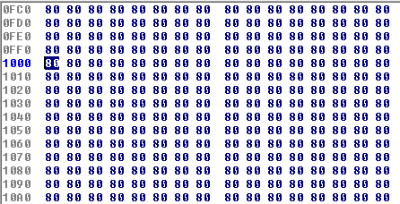
Flash unlocking – potential trickery
Modifying Flash is complicated
Requires sequence of memory-mapped commands such (erase, program byte, etc.)
“xor a \ ld (0000h),a” would NOT work – it is ignored
Example:
SP = 0x1000 (ROM page 0x00)
CALL SUBROUTINE
…
SUBROUTINE:
ret
We aren’t returning to after the CALL instruction, we’re returning to 0x8080!

Slide 23
Flash Protection “quirks”
Privileged sequence needs only to be read, not executed
This works:
ld ix,address_of_ED_byte
ld hl,address_of_F3_byte
rlc b, (ix+0)
ld d,(hl)
out (14h),a
Bytes fetched from privileged page: DD CB 00 00, ED, 56, F3
Z80 instruction equivalent: nop (00) \ nop (00) \ im 1 (ED 56) \ di (F3)
This does not require disabling interrupts or setting IM 1
We could set an IM 2 interrupt and steal away control…if these bytes were found on a privileged page

Slide 24
Flash Protection “Quirks”
With release of TI-83 Plus Silver Edition, port 0x05 was added
Controls last bank of memory map (0xC000 – 0xFFFF)
…TI did not update the Flash unlock checks to also validate the value of port 0x05
0x0000 – 0x3FFF
0x4000 – 0x7FFF
0x8000 – 0xBFFF
0xC000 – 0xFFFF
ROM Page 00
or
ROM Page 7F
Any ROM Page
or
Any RAM Page
Any ROM Page
or
Any RAM Page
Any RAM Page
(Port 0x06)
(Port 0x07)
(Port 0x05)

Slide 25
Flash Unlock Exploit
What happens if we swap the same RAM page into the last two banks?
ROM Page 7C
(Port 0x06)
RAM Page 01
(Port 0x07)
RAM Page 00
(Port 0x05)
ROM Page 00

Slide 26
Flash Unlock Exploit
What happens if we swap the same RAM page into the last two banks?
ROM Page 7C
(Port 0x06)
RAM Page 01
(Port 0x07)
RAM Page 01
(Port 0x05)
ROM Page 00

Slide 27
Flash Unlock Exploit - Continued
Jump into boot code that unlocks Flash, checks if OS is valid, and relocks Flash
OS valid bit at offset 0x1FE0 in certificate sector – entire byte is 0x00
This is read into OP1 (0x8478), contained in RAM page 0x01
0x8478 and 0xC478 (0x8478 + 0x4000) point to the same place now
Point SP to 0xC478 (last bank) give or take a few words
When boot code writes to 0x8478, value at 0xC478 (SP – return address) is corrupted
ex. Return address 0x46E1 becomes 0x00E1
We can steal control away at 0x00E1 via OS hooks

Slide 28
“Universal” flash unlock exploit
Port 0x05 trickery only works on 83+SE and up
83+ has no port 0x05 and is out of luck
Prior exploit requires OS hook to steal control
Also hard-coding locations in OS (version-specific)
Attack functionality that exists on *all* models
OS must support receiving of Flash applications from PC
Flash applications are larger than available RAM, so the OS *must* (in a loop):
Receive small chunk of Flash application into RAM
Unlock Flash
Write the Flash application chunk from RAM to *arbitrary* location in Flash
Re-lock Flash

Slide 29
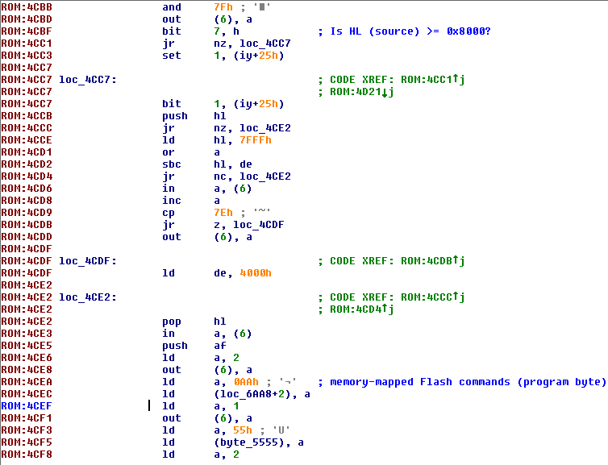
“Universal” Flash unlock Exploit
Z80 IY register is never modified by OS after boot – always 0x89F0 (base of OS bitwise flags)
Boot code uses IY in _WriteFlash
Bit 1 of IY+25h determines whether destination (DE) should wrap around to start of 2nd bank (0x4000)

Slide 30
“Universal” Flash unlock exploit
If flag was set, _WriteFlash would function as _FlashToRam
Copy chunk of data (such as all 0x80s) over the stack in RAM, and trigger return to 0x8080
But the code itself resets it, so there’s no way to make this happen
…or is there?
If IY points to Flash, a simple SET/RES Z80 instruction will not have any effect
Writes to Flash are complex memory-mapped instructions
Point IY to Flash where bit is set, jump into OS app-receiving code, and we’re done!
Fixed easily enough in OS, but there are more where this came from if needed

Slide 31
RSA PUBLIC key factoring
All 7 Flash-upgradeable models have OS and application 512-bit RSA key
14 total keys + 1 shared datestamp key
TI gave us the 83+ application signing (“freeware”) key
RSA’s strength is in inability to factor large (512-bit) number into two prime numbers
One person factored the 83+ OS public key with General Number Field Sieve
One PC, two months
TI “silenced” this person (came to house with legal threats)
Community created BOINC (Berkeley Open Infrastructure for Network Computing) distributed computing project
Factored 13 keys in *one* month without TI knowing

Slide 32
RSA Public Key factoring - Continued
Wrote signing tools to confirm valid factorings for all models
TI sent DMCA (Digital Millennium Copyright Act) notice
EFF (Electronic Frontier Foundation) stepped in
TI backed off
TI eventually countered – with secondary 2048-bit RSA key
Only present in boot code of newly-manufactured calculators (boot code v1.03)
Because hardware wasn’t designed for this, OS validation (after transfer) now takes SIX MINUTES
Unacceptable – back to Flash unlock exploits

Slide 33
Defeating New Signing key
Typical cold boot:
Boot code initializes hardware
Checks OS valid marker on sector 0
If marker is valid (value 0x5A at 0x0056), jump into OS
If marker is invalid (any other value at 0x0056), wait to receive new, valid OS
Typical OS transfer:
Invalidate the OS in certificate and erase sector 0 (resets OS valid marker)
In a loop:
Receive small chunk of OS into RAM
Unlock Flash, write small chunk to (bounds-checked) location in Flash, re-lock Flash back
Validate 512-bit signature (now easily bypassed)
(this is new) Validate 2048-bit signature
If all checks passed, mark the OS as valid in sector 0 and certificate

Slide 34
Defeating New Signing key – validating 2048-bit signature
Unlike the original 512-bit signature, the new one is length-indexed
e.g. 00 01 <0x100 bytes of signature data>
If the length is going to be a fixed 0x100 bytes, why length-index it?
…you guessed it, they don’t check the length
Embed a *really large* signature into OS update
Boot code will blindly copy signature to 0x8000
FF FF
0x8000: <…0x80 bytes of padding…>
0x8080: <C3 xx xx> (this is a Z80 jump to where payload will be)
0x8083: <…lots and lots of 0x80s that will totally overwrite RAM and the stack…>
0xXXXX: <code payload to execute>
Once we get control, do some cleanup (validate the OS ourselves in sector 0 and certificate, jump into newly-written OS)
No custom OS transfer tools required, exploits read-only* boot code

Slide 35
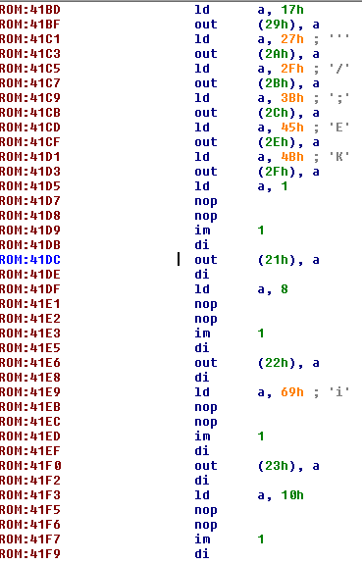
Boot Code Modification
TI-84 Plus and TI-84 Plus Silver Edition boot sectors are *almost* identical
In fact, other than the 1MB vs. 2MB Flash chip, they *are* identical…except for one I/O write
On the 84+, 0x00 is written
On the 84+SE, 0x01 is written
Both calculators run the same OS
Bit 0 of I/O port 0x21 is checked all over the place in the OS to determine which model it’s running on

Slide 36
Boot Code modification - Continued
Flash Pages 0x3C – 0x3D
(Upper OS Page Range)
Privileged
Flash Page 0x3F
(Boot Page)
Privileged
Read-Only
Flash Page 0x3F – 0x40
Flash Pages 0x00 – 0x08
(Lower OS Page Range)
User Archive (Flash applications, “archived” variables, etc.)
TI-84 Plus

Slide 37
Boot Code modification - Continued
Flash Page 0x3F – 0x40
Flash Pages 0x7C – 0x7D
(Upper OS Page Range)
Privileged
Flash Page 0x7F
(Boot Page)
Privileged
Read-Only
Flash Pages 0x00 – 0x08
(Lower OS Page Range)
User Archive (Flash applications, “archived” variables, etc.)
TI-84 Plus Silver Edition
Flash Page 0x7F – 0x80

Slide 38
Boot Code modification - Continued
Boot code initially sets this value, but what if we unlock Flash and modify it?
OS would believe 84+SE is actually 84+ and vice versa
Fun way to mess with people >:)
Flash Page 0x3F – 0x40
Flash Pages 0x7C – 0x7D
(Upper OS Page Range)
Privileged
(OS won’t use this anymore)
Flash Page 0x7F
(Boot Page)
Privileged
Read-Only
(OS won’t use this anymore)
Flash Pages 0x00 – 0x08
(Lower OS Page Range)
User Archive (Flash applications, “archived” variables, etc.)
Flash Pages 0x3C – 0x3F
(Upper OS Page Range and Boot Page)
TI-84 Plus Silver Edition

Slide 39
Boot Code modification - Continued
Boot code initially sets this value, but what if we unlock Flash and modify it?
OS would believe 84+SE is actually 84+ and vice versa
Fun way to mess with people >:)
Whaaaat?
Flash Page 0x3F – 0x40
Flash Pages 0x00 – 0x08
(Lower OS Page Range)
User Archive (Flash applications, “archived” variables, etc.)
Flash Pages 0x3C – 0x3F
(Upper OS Page Range and Boot Page)
Read-Only
Flash Pages 0x7C – 0x7D
(Upper OS Page Range)
Privileged
Flash Page 0x7F
(Boot Page)
Privileged
Writable
TI-84 Plus Silver Edition

Slide 40
Boot Code Modification - Continued
I/O port 0x21 isn’t just a register for holding the hardware model
…it actually controls the Flash write protection on the “last” sector
We can write to the supposedly-readonly boot sector
To write to 0x7F on an 84+SE:
Write 0x00 to I/O port 0x21 (effectively making it an 84+ non-SE)
Perform the Flash sector erase/write
Restore I/O port 0x21 value back to 0x01 (making it an 84+SE again)
To write to 0x3F on an 84+:
Write 0x01 to I/O port 0x21 (effectively making it an 84+SE)
Perform the Flash sector erase/write
Restore I/O port 0x21 value back to 0x00 (making it an 84+ again)

Slide 41
TI-84 Plus C Silver Edition
New model with color LCD
Identical to TI-84 Plus/Silver Edition (except for 4MB Flash chip vs. 1/2MB)
Even uses the same ASIC
4MB Flash chip has different sector layout compared to 1/2MB Flash chip
Flash pages now range from 0x00 to 0xFF (0x100 * 16KB = 4MB)
Read-only pages 0x6C-0x6F and 0x7F are now part of the user archive
So how does TI write to those pages?
They used our workaround
Did they get the idea from us?

Slide 42
TI-84 Plus CE – A new Form of Protection
Uses new eZ80 CPU
Z80 backwards compatibility*
16-bit I/O range
Flat memory model (no more pages to swap into 64KB region)
0x00XX range is “protected”
Writes to this range must come from “privileged” region
(controlled by privileged I/O ports 0x001D – 0x001F)
0x00000 – 0x20000
Boot Region
Read-Only
Privileged
0x20000 – (variable based on OS size)
Operating System
Writable
Privileged
User Archive (Flash applications, “archived” variables, etc.)

Slide 43
TI-84 Plus CE – bypassing protections
With any privileged I/O port write, TI must:
1. Load a constant value into a register
2. Write register value to protected I/O port
3. Immediately verify that register contains the same constant value, or lock up/reset
Otherwise we could just jump into the boot code at step 2 with our own value
OS size is variable, though; can’t hard-code it
Set our own register value, jump into boot code at write to I/O port 0x001D
Then steal away control (interrupts, whatever)

Slide 44
TI-84 Plus CE – the ultimate fail
eZ80 has backwards compatibility for running code in Z80 mode
ADL mode has access to 24-bit addressing, etc.
Any individual instruction can run in ADL mode or Z80 mode
In ADL mode, you can call a subroutine that runs in Z80 mode
When it returns, you’re back in ADL mode
In Z80 mode subroutine, you can have ADL instructions such as OUT/IN
Surely the protection on 0x00XX I/O ports works in both ADL and Z80 mode?

Slide 45
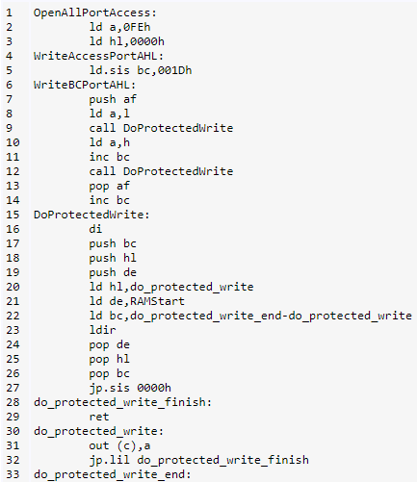
TI-84 Plus CE – The ultimate Fail
Write FE0000 (really high address) to I/O ports 0x001D-0x001F

Slide 46
TI-84 Plus CE – The Ultimate fail
…someone should be fired over this
The new models are less secure than the ones from 1997, and they were trying to improve upon it
I/O port protection is likely in ASIC, can’t be fixed through software updates
After the ASIC re-use with the TI-84 Plus C Silver Edition, there’s evidence to suggest fixing the ASIC is cost-prohibitive – this is likely here to stay
But if not…there are other ways

Slide 47
TI-82 Advanced (TI-84 Plus without I/O)
No more assembly program execution
No more Flash applications from PC (only built-in applications)
Resort to the original TI-82 hacks?
RAM backups?
Normally only something that happens over 2.5mm I/O port
TI attached a Press-to-Test LED to this I/O port, so it is no longer useful)
Unbeknownst to most, RAM backups do work over USB (sort of)
Custom backup sender from PC
Backup functionality finally removed with TI-84 Plus T

Slide 48
Where do we go from here?
Release new exploits
TI-Nspire – Ndless
Stay on top of TI-84 Plus CE/TI-83 Premium CE developments
Method of code execution for TI-82 Advanced and TI-84 Plus T

Slide 49
In conclusion
Calculators are great educational tools
Do not legal threats intimidate you
The community needs your help
Contact me:
http://brandonw.net
brandonlw@gmail.com
@brandonlwilson
http://youtube.com/ti83programmer
http://github.com/brandonlw

